Slide 1
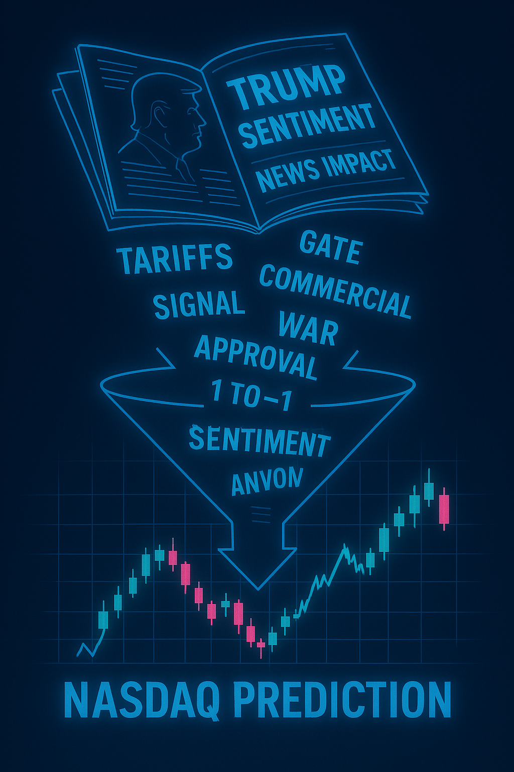
NASDAQ UP/DOWN PREDICTION ADDING NEWS SENTIMENT ABOUT TRUMP
Roberto Carlos Escalante ID 300383075
Carlos Sibaja Jimenez ID 300384848

Slide 2
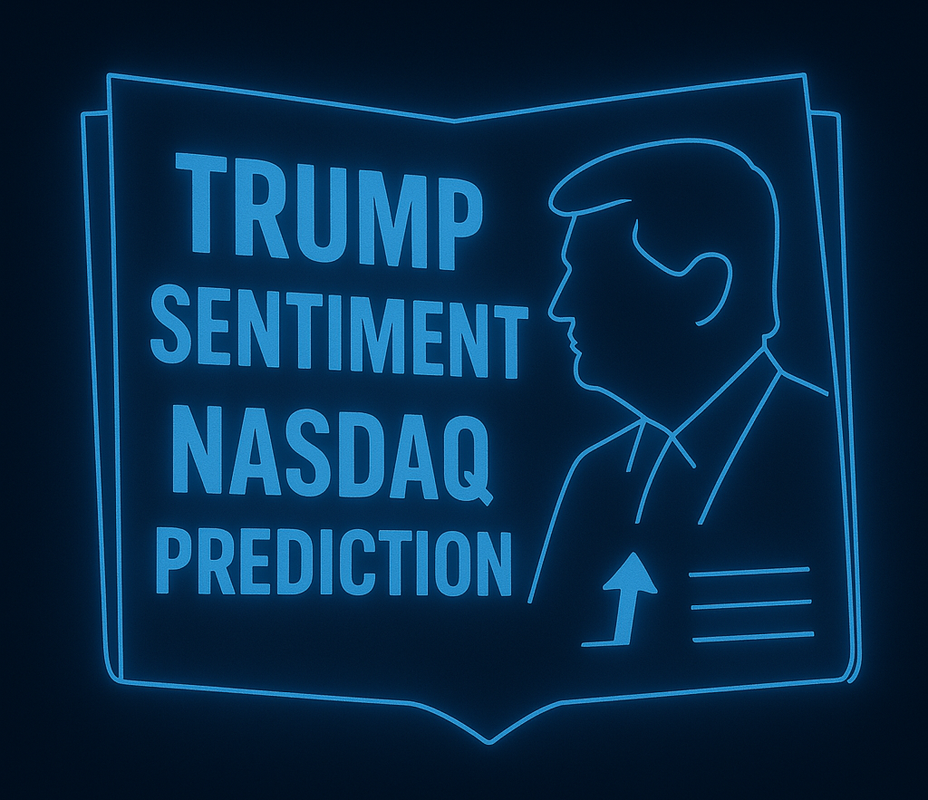
CONTENTS
Hypnosis
Approach
Model Components
Fine-Tuning & Challenges
Results
Code / Read Me

Slide 3
Approach
Financial Data.
Scrap the Nasdaq Index from Jan 2023 to March 2025, CSV file created.
Add the Technical Indicators. In this stage, we added as many as possible, avoiding duplications (for later feature importance).
Sentiment Data
Scrap the article news from ten sources randomly selected (max 33/day, max 12/source). For the same period of the financial data, a CSV file was created (date, source, link). The quantities were defined based on the resource capabilities at the minimum that provide a valid sentiment average, and the sources were randomized and weighted according to political bias.
Fetch content: Based on the news scraped, the content was fetched, and the sentiment per day was calculated (Friday, Saturday, and Sunday were considered as one day - Friday).
Sentiment added to the financial data: As t1, day before, t2 two days before and t3 and t123AVG, to test with day lag provide better performance (for later feature importance)

Slide 4
Approach
Model.
We start with the idea to perform a regression using Random Forest. After evaluating the performance, we identified a huge overfitting. We used several actions to reduce the overfitting, but the results were insufficient. (R² 99% in the training set and very low in the test set).
Our research shows us that classification for UP/DOWN was a better approach because it is a good practice in trading to predict the change in the direction and not the value of the change.
The selected classification model was XGBoost (XGBClassifier), a supervised machine learning algorithm based on decision trees optimized through boosting.
Features:
Lag Features: Close_lag1, Close_lag2 (previous closing prices), VWAP_lag1, VWAP_lag2 (Volume Weighted Average Price lags) Technical Indicators: Volatility (5-day rolling standard deviation of returns), OBV (On-Balance Volume), ATR_14 (Average True Range), ADX_14 (Average Directional Index)
Data Splits
Training Data (2022-2023): Used to train the model.
Validation Data (2024): Used to evaluate the model's performance on unseen data.
Real Prediction Data (2025): Predictions for the first quarter of 2025.
Evaluation Metrics
Accuracy (DA): Percentage of correct predictions.
Precision: Proportion of true positives among predicted positives.
Recall: Proportion of true positives among actual positives.
ROC_AUC: Area under the ROC curve, measuring the model's ability to distinguish between classes.

Slide 5
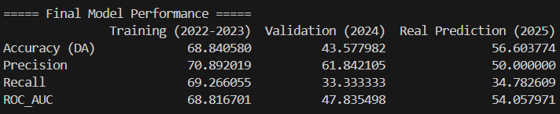
Approach
Model.
The model suffered several changes to improve performance but avoided overfitting.
We achieved 56% accuracy using the financial variables and called it a based-model.
The Sentiment variables were added to the base model, and a process to fine-tune them was performed. With the aim to improve the overall performance (a final-model).
The main changes applied were.
A
A
A
A

Slide 6
Components
Module 1: News Scraper.
M1config.py : Contains configuration settings for the scraper, including a dictionary of news sites with their URLs and CSS selectors for extracting content. It also includes comments on managing the virtual environment and installing dependencies.
M1scraper.py: Implements the main scraping logic, using the configurations from M1config.py to fetch and parse data from the specified news sites.
M1utils.py: Contains utility functions to support the scraper, such as helper methods for making HTTP requests, parsing HTML, handling errors, or saving data.
M1_ScraperContent.py: Focuses on extracting article content from URLs provided in a CSV file. It uses the newspaper library to download and parse articles and saves the extracted content to a CSV file.
M1_Sentimient_Analysis.py: Performs sentiment analysis on the scraped news content. It may use natural language processing (NLP) techniques to classify the sentiment (e.g., positive, negative, neutral) of the articles.

Slide 7
Components
M2_nasdaq_extractor.py: Extracts financial data related to the NASDAQ stock market, includes functionality to fetch historical stock prices, calculate technical indicators, and save data into a CSV.
M3_Base Model.py: XGBoost uses only the financial variables after adjustments to features, threshold, and other improvements. Implemented a machine learning pipeline to predict significant stock returns based on economic data and technical indicators, and performance indicators.
M3_Final Model.py: XGBoost combines the sentiment and financial variables. Implemented a machine learning pipeline to predict significant stock returns based on economic data, technical indicators and sentiment, and performance indicators.

Slide 8
Fine-Tuning & Challenges
APIs. The free version had a limited span of news or stock; after implementing them, we found it impossible to reach the complete data set.
News Scraping.
Bias Control: To avoid having one source or unbalanced sources, we need to customize the selectors, and it takes a lot of time.
Scraping time: We had a more manual scraping pipeline ( not paid API). The scraping took more than 24 hours, and we wasted time after some bugs deep in the process took us back to the beginning.
Scraping Flexibility. Many pages had bot defenses of time limits and maximum pages per view lower than we needed. So, we need to adjust the scraper pipeline to reach more news.
Improving the Model Performance. Overfitting was a bit challenging, as we had to try many different versions of the model and research techniques on the trading marked for prediction.
What is a good performance? We put a lot of effort into trying to improve the model because we thought we had a very low performance. After researching, we learn that about 65% for a stock prediction is considered good.

Slide 9
Results
M2

Slide 10
Final Takeaways
We discovered a lot of new tools and learned about the challenges of making a viable project. Even though there are tools that can automatize a lot of the work with a few clicks for us, it was a very variable experience to overcome all the challenges and be able to produce a good product.

